Slide 1
Developing an IoT System
Uli Raich (uli.raich@gmail.com)
Two lectures on Hardware and Software for the Internet of Things
Lecture 1: Introduction to the hardware and development environment and access to the “things”
Presented online at the African Internet Summit Mauritius 2021

Slide 2
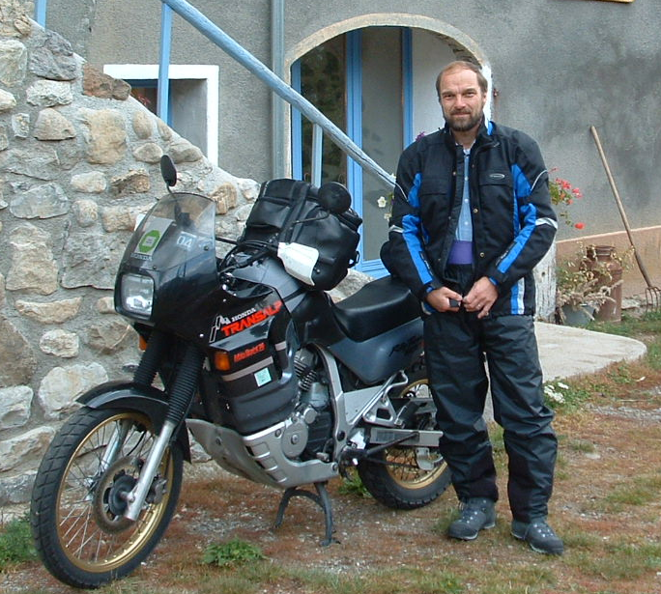
Introduce myself
Dr. Ernst Ulrich Raich short: Uli
PhD in Physics (not computer science!) but 4 years of IT studies without diploma.
Married, 3 adult children, 2 grand children
Staff member of CERN for 35 years now retired
Teaching (short microprocessor courses) since 1980
Guest lecturer at the University of Cape Coast 2017 Set up a microprocessor lab and gave a full semester course on embedded systems
Based on Raspberry Pi and the C language

Slide 3
About this tutorial
This is not just a talk, but the tutorial aims a demonstrating with live programs all the concepts that are explained.
Some of you may want to re-create the demos after the tutorial. Therefore, I will give you a list of all devices (cost ~ 25 Euros) needed to do so, in a later slide.
All the course material:
The firmware running on the micro-controller
The slides
The driver for the temperature and humidity sensor
The demo programs
are available on github: https://github.com/uraich/AIS-2022_IoT_Tutorial

Slide 4
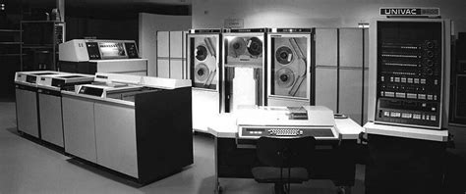
The Microprocessor Revolution
From all technical advances during the last 50 years the development of micro-processors certainly had the biggest effect on our daily life.
When I was a student a computer looked like this:
It filled a whole room and the cost was
several 100 k$

Slide 5
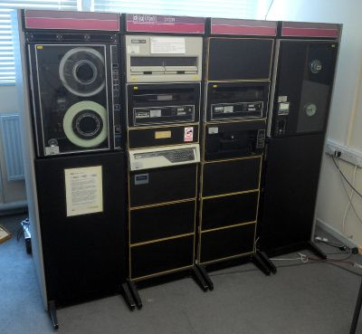
Minicomputers
When I was a doctoral student this was the computer I worked with:
It fitted into a rack
Cost: several 10 k$
Typical memory size: 128 kBytes
Hard disk: 600 Mbytes (which was huge!)
Black and White serial terminal for programming
On such a machine the Unix OS was developed

Slide 6
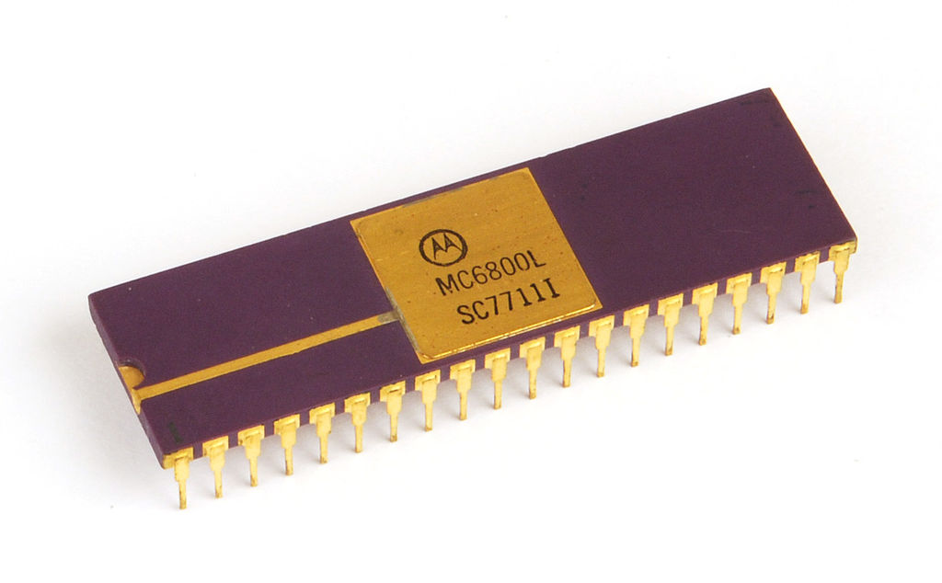
The first Microprocessors
… and then came the Microprocessor
The first one I played with was the Motorola MC6800, 8bit microprocessor
Cost at introduction: ~ 500 $ US
Clock frequency: 1 MHz
Only external memory (my first system had 128 Bytes)
“OS” in EPROM (ca. 2 kBytes)
External parallel and serial interface
Programs were stored on audio tape
Total cost of a system: ~ 2000 $US
Programmed in binary machine code entered through a keypad

Slide 7
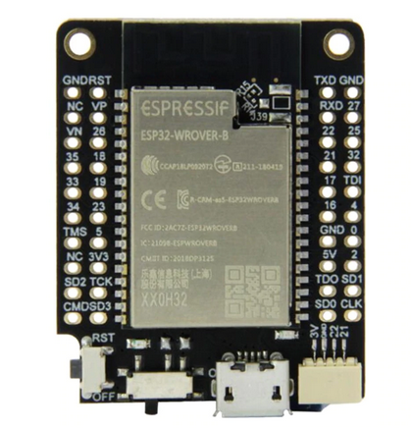
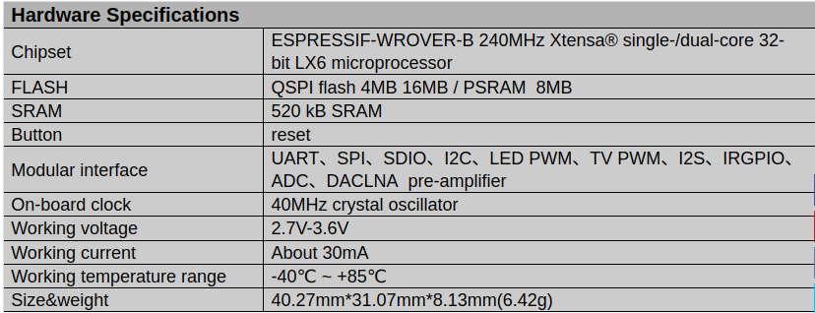
… and today? for 10 Euros?

Slide 8
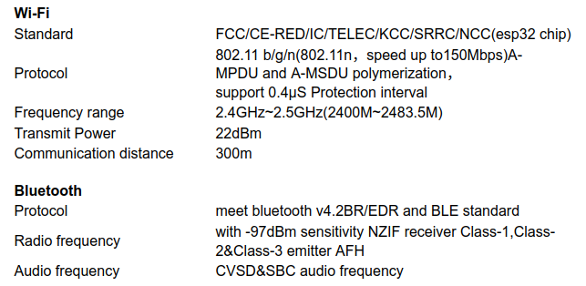
ESP32 network connection

Slide 9
What is IoT
IoT stands for the Internet of Things.
We need:
A processor powerful enough to run the network protocol layers
A network interface: either Ethernet of WiFi
Interfaces to the things:
General Purpose I/O (GPIO) lines
I2C, I2S, SPI, serial interfaces
The cost for the controller should be in a good relation with the cost of the things

Slide 10
Where do we find micro-controllers?
Answer: Everywhere!
Car (many of them!)
Coffee machine
TV set, radio
Watch
Hand phone

Slide 11
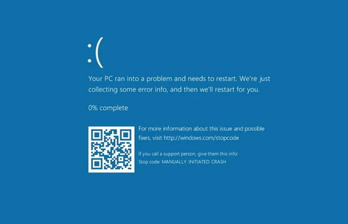
What used to be a joke
Two engineers standing around a coffee machine with this screen
One saying to the other:
“Those were the good old times when coffee machines still worked without Windows”

Slide 12
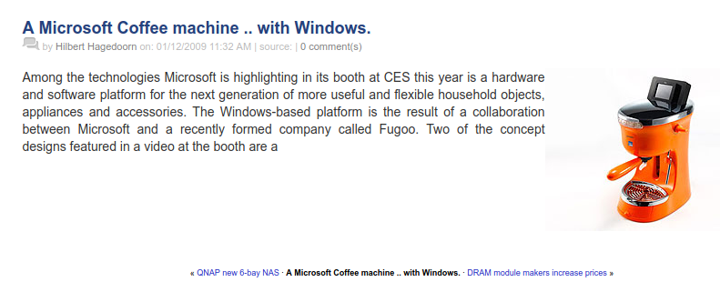
...becomes reality

Slide 13
University courses on IoT
When asking African colleagues about micro-controller courses (embedded systems or IoT) in Africa I often get the answer:
We have no such course, the micro-processor lab would be too expensive.
I wanted to find out and I therefore prepared such a course for the University of Cape Coast, Ghana. The cost for 1 experimental station was ~ 50 $ US. If you run the course for 5 years this gets you to a cost of 10 $ US per student and year! This is cheap enough to allow students to take the equipment home for experimentation!
The real problem is that there are too few lecturers capable of preparing and running such a course and preparation of exercises and solutions is very labor intensive. (I took 6 months for the preparation)
Much of the following material has been extracted from the UCC IoT course.

Slide 14
Documentation of UCC IoT course
The IoT course was given at the University of Cape Coast, Ghana, for the first time at the beginning of 2021
Everything is documented on a TWiki server located in Accra
It consists of
Hardware and software documentation with plenty of links to relevant WEB pages
Explanations for a range of experiments (exercises)
Lecture slides
Exercise sheets
Solutions to the exercises that can be downloaded from a github repository
Efforts are under way at the Université Cheik Anta Diop, Dakar, Sénégal, to provide a similar course with all documentation written in French, which you can find on the above Twiki server.

Slide 15
Processors for IoT
There is a huge selection of different chips:
STM32: ARM Cortex MCU. This is a whole family of chips with different performance and price.
Raspberry Pi: The RPi is more like a little computer. It has a quad core micro-controller capable of running an ARM based Linux OS. All you need to make this a full computer is a keyboard, a mouse and a screen.
ESP32 based boards: Dual core processor, SRAM and flash on chip. WiFi and BlueTooth implemented on chip.

Slide 16
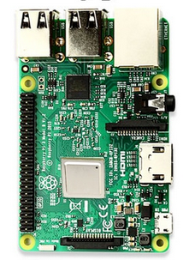
Which one should I use?
The Raspberry Pi is a small computer powerful enough to run a full blown Linux operating system:
A quad core 1.2 GHz Broadcom 64 bit ARM CPU
1 Gbytes of Ram
Ethernet and wireless networks
4 USB2 ports
Micro SD connector
40 pin extended GPIO connector with
GPIO pins
SPI and I2C bus interface
Cost ~ 80-100 US $
No ADC

Slide 17
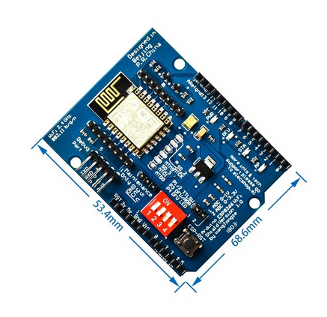
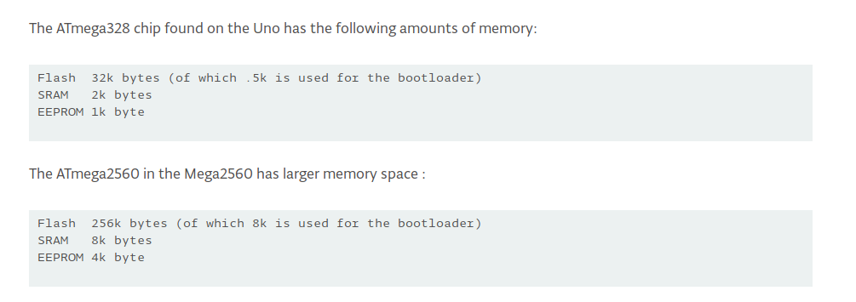
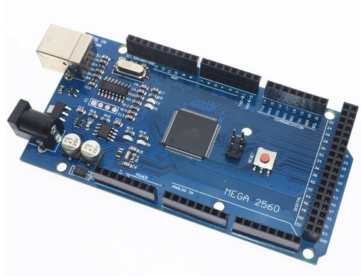
Arduino + WiFi shield
Cost: ~12-15 US $
Popular because of simple C++ IDE

Slide 18
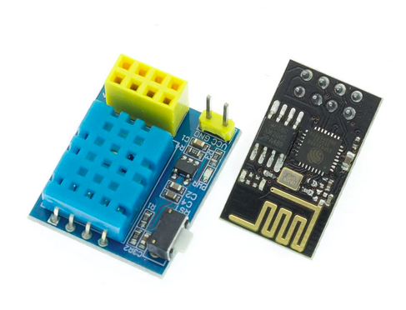
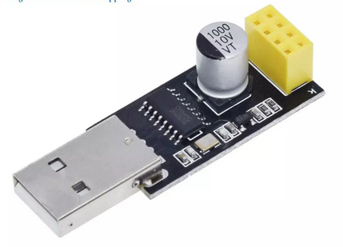
The low end
If you just need an Internet connected temperature sensor, the ESP01 will do!
Cost of processor and sensor: < 2 US $
In addition ou need a programmer for a few cents.
Temperature sensor
programmer
processor

Slide 19
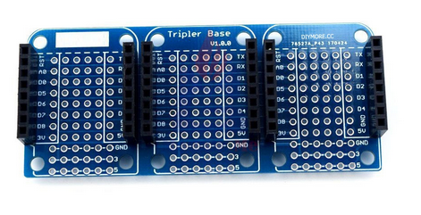
Sensors and Actuators
For the IoT course I selected the WeMos D1 mini series of boards.
It provides a selection of CPU boards
ESP8266 CPU
ESP32 with or without SPIRAM
and it comes with a large selection of sensor/actuator boards
The sensor boards are connected to the
CPU through a simple plug and play system

Slide 20
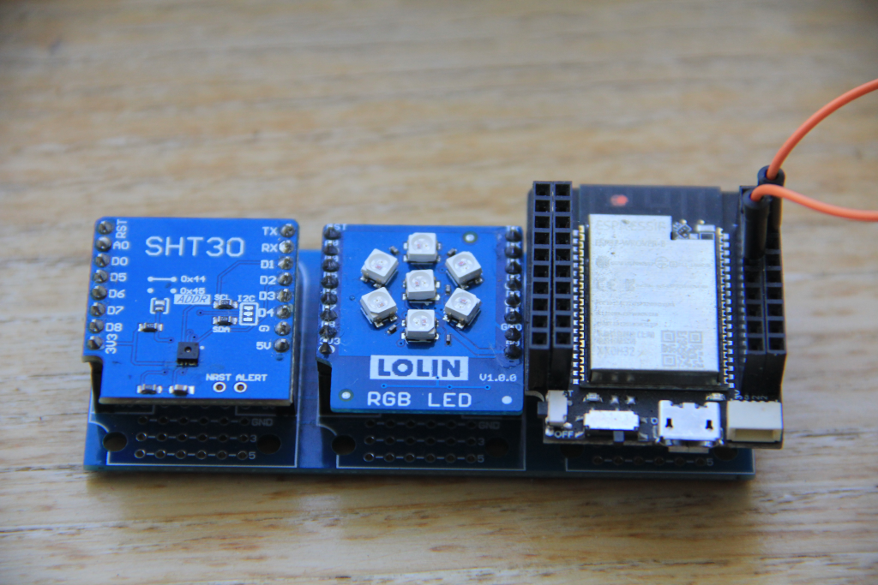
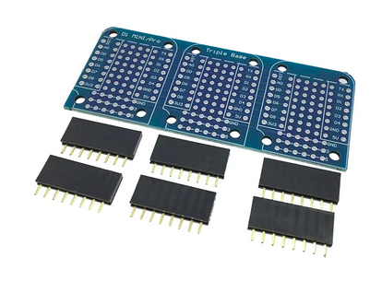
Connection between CPU and sensors

Slide 21
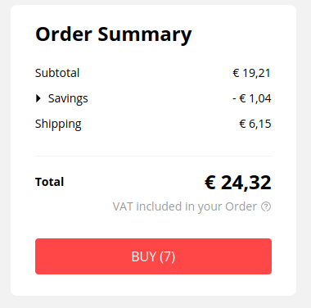
Cost of devices shown in this tutorial
The WeMos T7 V1.5 CPU board
The triple base with connectors
The SHT30 temperature and humidity sensor
The rgb LED ring
The micro USB cable for communication with the PC
Linear potentiometer

Slide 22
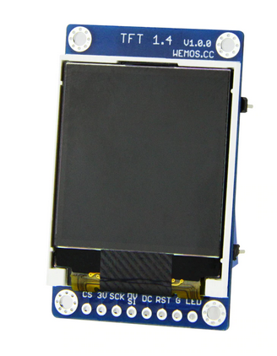
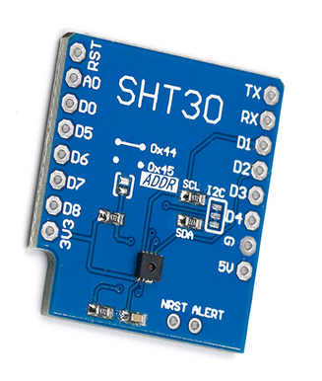
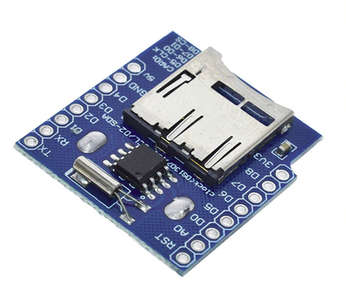
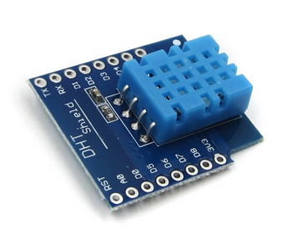
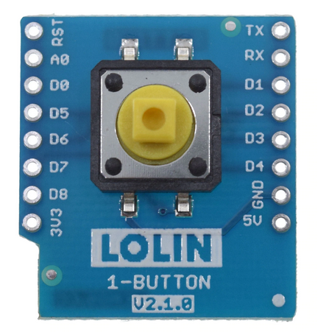
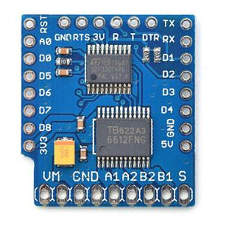
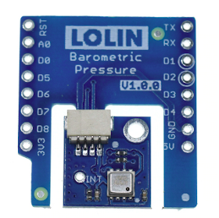
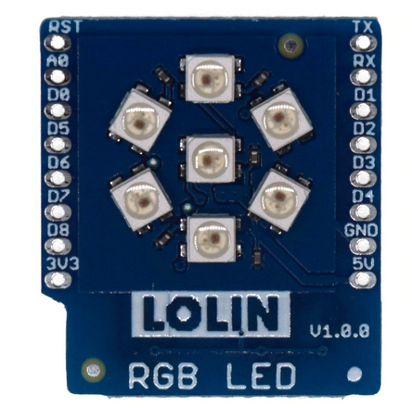
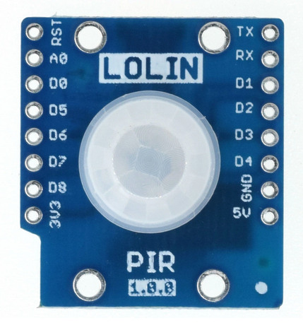
… a big number of sensor shields

Slide 23
WeMos D1 sensors
Here is an incomplete list of sensor and actuator modules:
user LED on CPU module
Simple mechanical push button
WS2812 single rgb LED or LED ring with 7 LEDs
IR sender and receiver
Passive buzzer
PIR sensor
DS18b20 digital temperature sensor
BMP180 barometric pressure sensor
SHT30 I2C temperature and humidity sensor
DHT11 temperature and humidity sensor
Ambient light detector
RTC and data logger with SD card interface
Relay module
DC motor controller
and so on ...

Slide 24
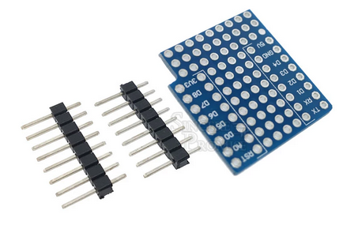
Prototype Boards
If this is not enough, you can mount small sensor boards onto a WeMos D1 mini prototype board and interface it to your ESP32 CPU.
We will see an example later.

Slide 25
How to develop code
The Raspberry Pi is a bit different than the others: Here the compiler can run natively on the Pi. If you know Linux, then you know how to develop on the Pi.
All other CPU suppliers provide a cross-development environment with their chips.
The ESP32 CPU is described in a manual of more then 1000 pages! The library to access all the hardware functionality is huge.
Espressif (the company behind the ESP32) supplies esp-idf, a build system based on cmake and the hardware access library. Programming is done in C or C++.
The learning curve to start your first application is very steep.
The same is true for the STM32 chips.

Slide 26
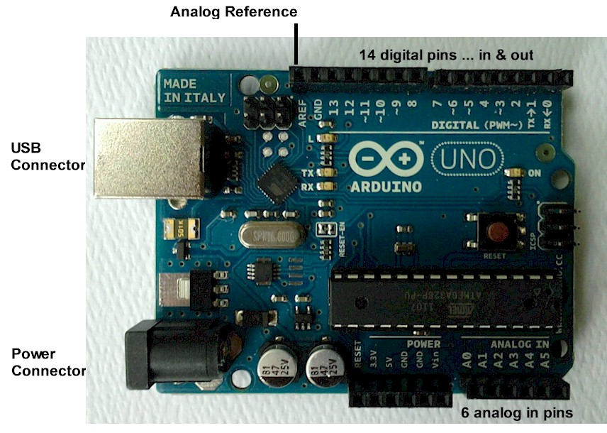
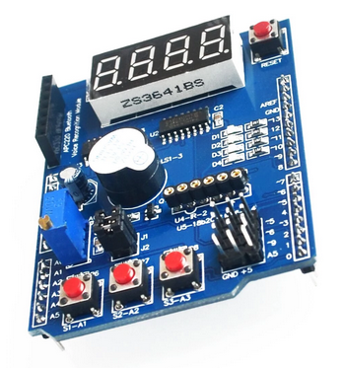
The Arduino
Open source hardware
Shields

Slide 27
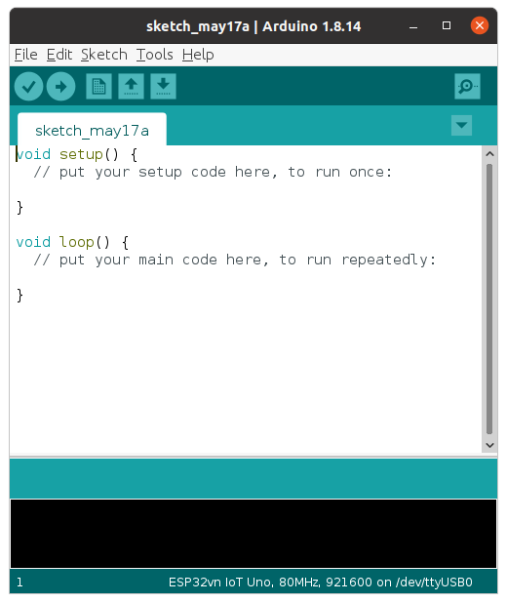
Arduino IDE
Designed for the beginner and hobbyist market
Originally provided for the AVR processors but now also available for ESP8266, ESP32 or the STM32 processors
Uses a C++ like language
Simplifies program development a lot
Comes with a huge collections of examples and libraries
Upload and flash programming is integrated

Slide 28
MicroPython
MicroPython is stripped down Python interpreter based on Python 3.5 and dedicated to micro-controllers. It is provided in source format in form of a github repository
Excellent documentation is provided and if this is not enough you can have a look at the source code
A very active user forum helps in case of problems
However:
It needs quite a bit of infrastructure on the PC to be able to cross-compile Micropython, which depends on
The xtensa-esp32-elf-gcc cross compiler
The espidf libraries
esptool to erase and program the ESP32 flash
ampy of ftpd to transfer files to the ESP32 file system
Micropython exists for a series of micro-controllers, the ESP32 being a popular port.
The interpreter is written in C

Slide 29
Bringing up the system
MicroPython is built using a Makefile
It uses Espressif’s build system based on cmake
esptool is used to burn the firmware into the ESP32 flash (esptool is accessed by the Micropython Makefile such that make deploy will flash the firmware)
MicroPython REPL can be accessed through a USB to serial adapter combined with a virtual terminal program like minicom or gtkterm
MicroPython can also be accessed over the network
A working custom binary of MicroPython, built for the UCC course, is available on github
Programs are written on the PC and uploaded to the MicroPython file system before being executed
We use the thonny IDE to simply the procedure

Slide 30
Learning Python
In the first lecture and exercise session we give an introduction to Python. Basic knowledge of Python is a major advantage. If you are totally new to the language then go through the Python tutorial first.
We use the Python interactive shell REPL (the Read, Evaluate,Print Loop) to get acquainted with Python
We write our first simple Python scripts using thonny
Since none of the example programs depends on specific hardware we can run the programs on the PC or on the ESP32
The exercise sheet is available on the Twiki and as Libreoffice document

Slide 31
How do we talk to the ESP32?
The CPU board has a Micro USB connector and a USB to serial converter.
We connect it to the PC with the same micro USB cable you use on your smart phone for charging and data transfer.
We can use a serial terminal emulator to communicate with the ESP32 or the thonny IDE for communication and program development

Slide 32
Communication tools
Serial communication:
minicom
gtkterm
rshell
File transfers:
ampy
rshell
ftp, needs the ftp server to be running on the ESP32
IDE:
thonny
pycharm

Slide 33
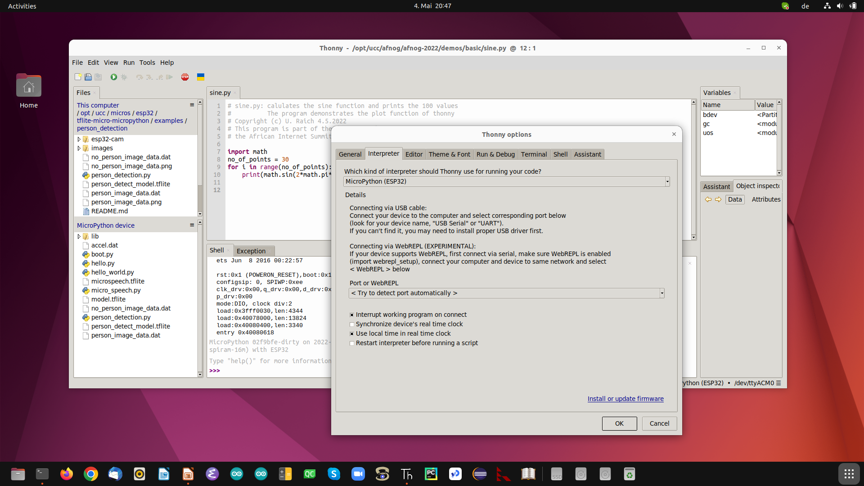
thonny
d

Slide 34
Interfacing to the “things”
The ESP32 has a big number of interfaces implemented on the chip:
GPIO pins
PWM
Capacitive touch sensor
I2C interface
SPI interface
Analogue to digital converter
Digital to analogue converter
Timer

Slide 35
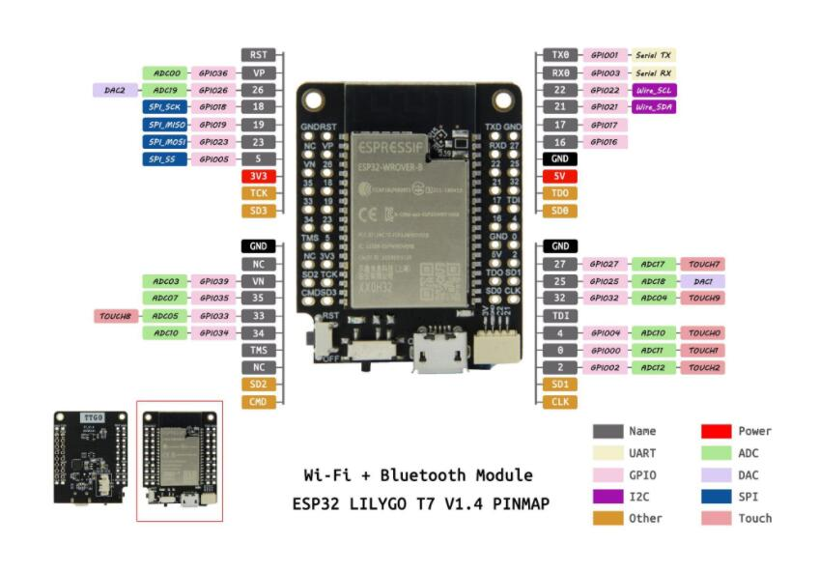
ESP32 pinout

Slide 36
GPIO
A big number of General Purpose Input/Output lines
These lines can be programmed as outputs or inputs with or without pull-up resistors
They are used to control:
LEDs, relays, stepping motors…
You can implement serial protocols in “bit-banging” mode
or they can be used to read
status bits, switches

Slide 37
GPIO driver in MicroPython
The GPIO driver in MicroPython makes GPIO access super simple:
We use the class Pin in the machine module:
from machine import Pin
led = Pin(19,Pin.OUT) # GPIO 19 connects to the user LED
led.on()
is all that is needed to control a LED (or a relay)
We even do not need a program to accomplish this.
Let’s try!
d

Slide 38
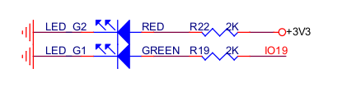
User LED connection
Many ESP32 CPU boards use GPIO 2 to connect to the user LED.
How do I know that the user LED is connected to GPIO 19?
The circuit diagram of the board is available at
https://github.com/LilyGO/TTGO-T7-Demo/blob/master/t7_v1.5.pdf
d

Slide 39
The blink program
With the C programming language the ubiquitous Hello World program has become well known.
It is the most simple program you can possibly write in C, printing “Hello World!”
It is useful to demonstrate that the programming infrastructure
Editor, compiler, linker
Program execution
work well.
The equivalent in the world of embedded systems or IoT is the blinking LED.
d

Slide 40
Pulse Width Modulation
How can we change the LED light intensity with a single digital GPIO line?
The answer is: Pulse Width Modulation (PWM)
Instead of emitting a steady zero or one signal level we emit a frequency (the modulation frequency) and we change the time in which the signal is high during a pulse (duty cycle)
The frequency is high enough and the LED persistence long enough, such that the human eye cannot resolve the frequency.
The average current through the LED is changed and such the light intensity.
PWM is also used to control servo motors

Slide 41
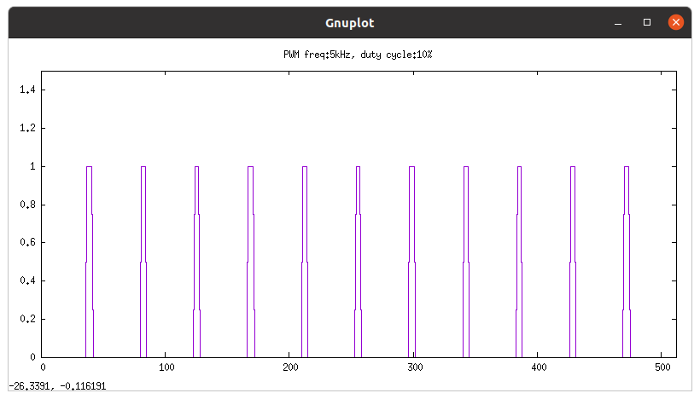
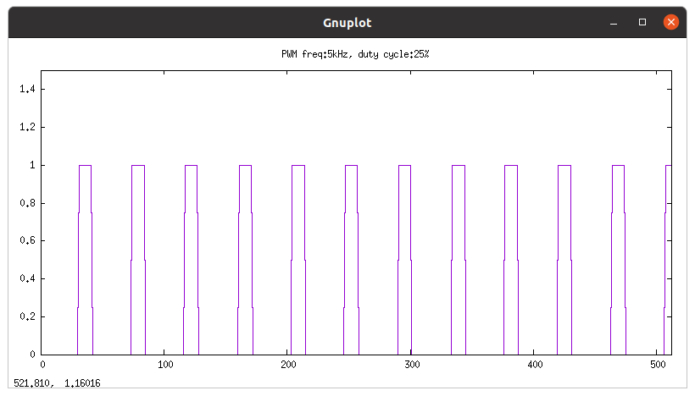
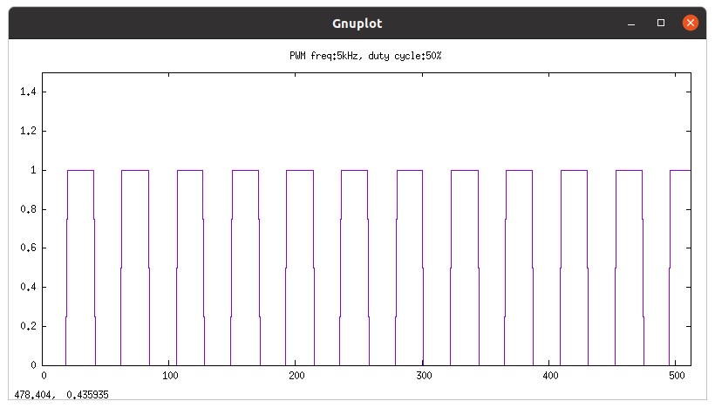
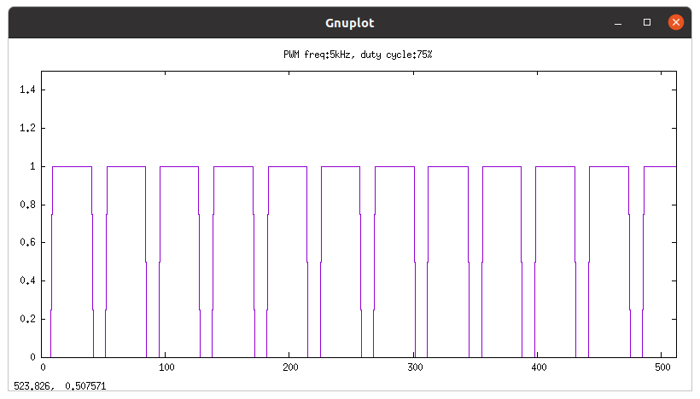
PWM
d

Slide 42
NeoPixels
The addressable rgb LED of type WS2812 is used in many LED chains
It uses a sophisticated timing sequence to set an individual LED in the chain
We use a simple, 7 LED chain for demonstration purposes
MicroPython provides the NeoPixel driver, which looks after the protocol and its stringent timing requirements
The sensor shield uses GPIO 26 to control the NeoPixels
d

Slide 43
Analogue Signals
The ESP32 has two 12bit Analogue to Digital Converters (ADCs) with a total of max 18 input channels
We will use ADC1 on GPIO 36
The ADC accepts signal levels 0..1V but there is an attenuator in front of it extending the signal range
An attenuation of 11dB provides an input range of ~ 0..3.6V fitting well with the 3.3V Vcc of the CPU board
Again the MicroPython ADC driver provides easy access to the hardware

Slide 44
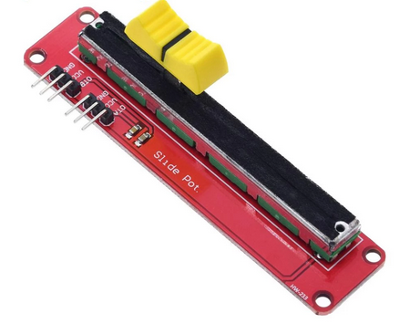
Linear Potentiometer
To test the ADC on the ESP32 we can connect a 10 kΩ potentiometer
There are 3 pins:
Vcc → 3.3V
GND → GND
OTA(B) → ADC
When you move the slider you get voltage levels 0V .. 3.3V on OTA(B)
d

Slide 45
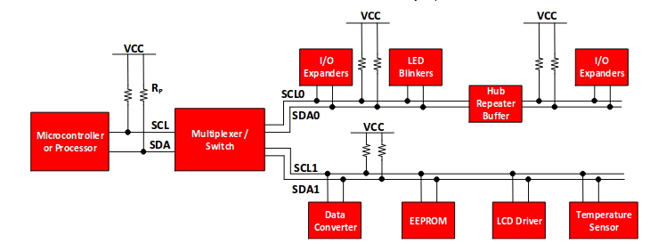
The I2C bus
The Inter-Integrated Circuit (I2C) bus was invented be Philips in the early 1980. It is used by many sensors to communicate their data to the CPU.

Slide 46
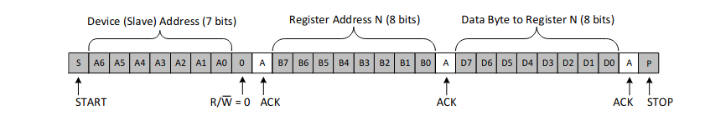
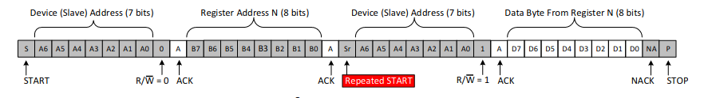
The I2C protocol
Write to the bus
Read from the bus
7 bit device address + R/W bit

Slide 47
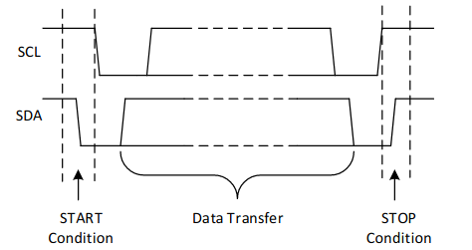
Start and stop conditions

Slide 48
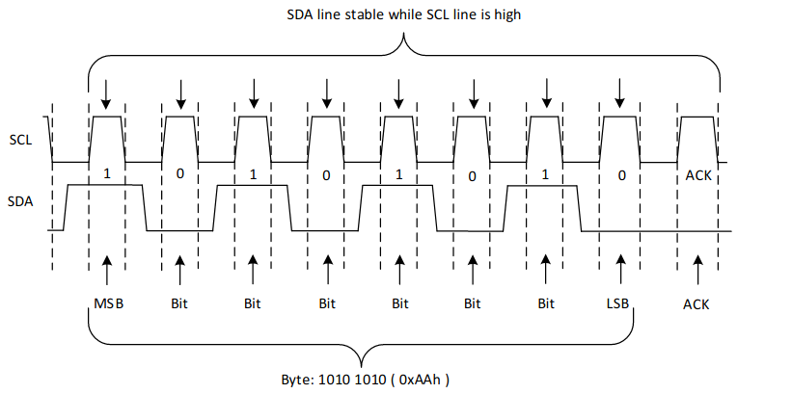
Data transfers

Slide 49
I2C addressing
The I2C bus uses the master/slave paradigm. The CPU acts as the master and the sensors as slaves.
The I2C bus uses 7 address bits (the 8th bit is the R/W line). A maximum of 128 slaves can therefore be connected to a single master.
The ESP32 has two hardware I2C buses, but MicroPython also provides a software I2C implementation using bit-banging on any GPIO line.
The pins for SCL (the I2C clock line) and SDA (the I2C data line) are
SCL: GPIO 22
SDA: GPIO 21
Control and readout of an I2C based sensor requires a driver accessing it using the MicroPython I2C driver calls. An example for the SHT30 temperature and humidity sensor is explained here.

Slide 50
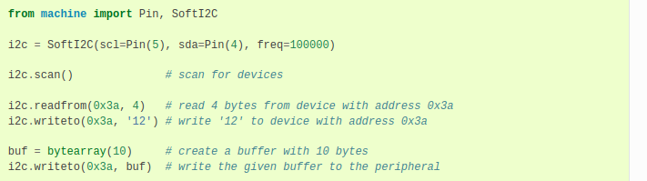
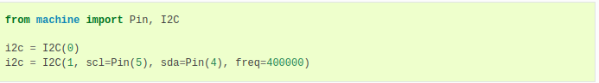
MicroPython’s I2C driver
From the MicroPython doc on the I2C bus for the ESP32
On the ESP32 CPU:
scl : GPIO 22
sda: GPIO 21

Slide 51
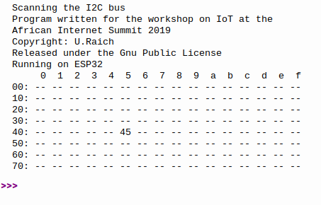
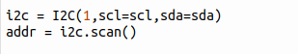
Scanning the I2C bus
d

Slide 52
The SHT30
The SHT30 is a digital temperature and relative humidity sensor
I wrote the sht3x driver myself and integrated it into the MicroPython firmware
The user program becomes very simple:
from sht3x import SHT3X sht30 = SHT3X() tempC, humi= sht30.getTempAndHumi(clockStretching=SHT3X.CLOCK_STRETCH,repeatability=SHT3X.REP_S_HIGH)
is all that is needed to get at the measured temperature (in °C) and relative humidity (in %) values.
All the detailed command handling is done within the driver
d

Slide 53
Drivers are classes
Drivers are often implemented as Python classes
When an instance of a class I created the __init__ method its called This method initializes the I2C bus and performs any initialization that the device may need.
The ESP32 has 2 hardware I2C interfaces and I2C bus 1 is reserved for users.
MicroPython includes a driver for the I2C bus whose methods are used with in driver for the specific I2C device.

Slide 54
!!! Pause !!!
Question and Answer Session

